Slide 1
Governance (Access, Permissions and Security)
Original slides belong to: Amit Dandekar And Dr. Hossein Saiedian

Slide 2
Contents
Security requirements
SQL security model
Data sensitivity
Security vs. Precision
Inference & aggregation problem
Multilevel databases
Future direction

Slide 3
Database Concepts
Structured Query Language (SQL)
  to manipulate relations and data in a relational database
Types of SQL Commands
  Data Dictionary Language (DDL)
    define, maintain, drop schema objects
  Data Manipulation Language (DML)
    SELECT, INSERT, UPDATE
  Data Control Language (DCL):
    Control security (GRANT,REVOKE) and concurrent access (COMMIT , ROLLBACK)

Slide 4
Security Requirements
Physical database integrity
Logical database integrity
Element integrity
Auditability
Access control
User authentication
Availability

Slide 5
Security Requirements
Physical database integrity
  immunity to physical catastrophe, such as power failures, media failure
    physical securing hardware, UPS
    regular backups
Logical database integrity
  reconstruction Ability
    maintain a log of transactions
    replay log to restore the systems to a stable point
Notes:
Two situations can affect the integrity of a database: when the whole database is damaged (as happens, for example, if its storage medium is damaged), or when individual data items are unreadable.
data must be protected from corruption, either by an outside illegal program action or by an outside force such as fire or a power failure.

Slide 6
Security Requirements
Element integrity
  integrity of specific database elements is their correctness or accuracy
    field checks
      allow only acceptable values
    access controls
      allow only authorized users to update elements
    change log
      used to undo changes made in error
    referential Integrity (key integrity concerns)
    two phase locking process
Auditability
  log read/write to database
Notes:
DBMSs sometimes take special action to help catch errors as they are made and to correct errors after values are inserted.
the DBMS can apply field checks, activities that test for appropriate values in a position.
Check for value bounds , value types (numeric/character/boolean) , other conditions such as case
Access Controls : Who has authorization to update which elements? What if two people apply conflicting modifications?
What if modifications are applied out of sequence? How are duplicate records detected? What action is taken when duplicates are found?
Change logs : A change log lists every change made to the database; it contains both original and modified values. Using this log, a database administrator can undo any changes that were made in error.
Audibility
For some applications it may be desirable to generate an audit record of all access (read or write) to a database. to discover after the fact who had affected what values and when.
To be useful for maintaining integrity, database audit trails should include accesses at the record, field, and even element levels. This detail is prohibitive for most database applications.
Problem : A log of all records accessed directly may both overstate and understate what a user actually knows

Slide 7
Security Requirements
Access Control (similar to OS)
  logical separation by user access privileges
  more complicated than OS due to complexity of DB
User Authentication
  may be separate from OS
  can be rigorous
Availability
  concurrent users
    granularity of locking
  reliability

Slide 8
SQL Security Model
SQL security model implements DAC (Discretionary Access Control) based on
  users: users of database - user identity checked during login process;
  actions: including SELECT, UPDATE, DELETE and INSERT;
  objects: tables (base relations), views, and columns (attributes) of tables and views
Users can protect objects they own
  when object created, a user is designated as ‘owner’ of object
  owner may grant access to others
  users other than owner have to be granted privileges to access object

Slide 9
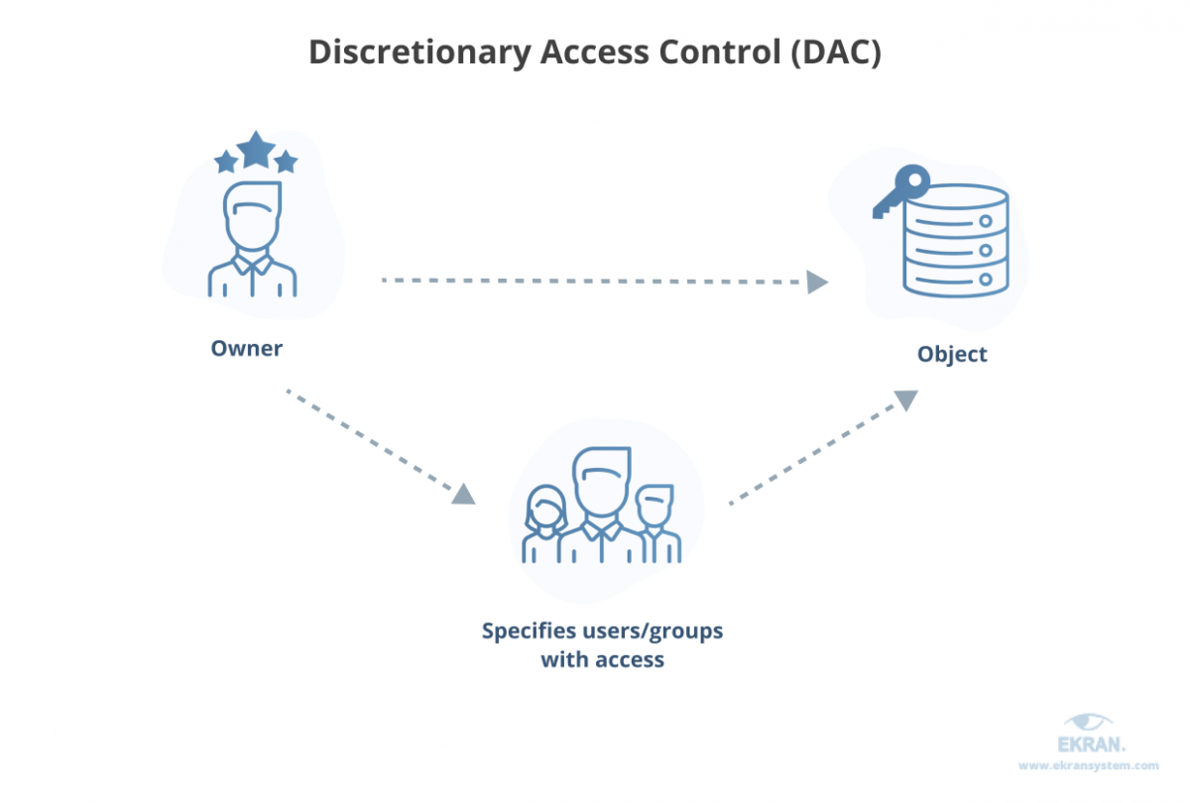
DAC

Slide 10
What are the basic principles of DAC?
Object characteristics (size, name, directory path) are invisible to users that aren’t authorized.
Several failed access attempts enforce additional multi-factor authentication or deny access.
Users can transfer their object ownership to other users. Also, the owner determines the access type of other users. Based on these access privileges, the operating system decides whether to grant access to a file.
Gaining access to a file in the DAC model works like this:
User 1 creates a file and becomes its owner or obtains access rights to an existing file.
User 2 requests access to this file. They provide their credentials: username, password, or something else.
User 1 grants access at their discretion. However, user 1 can’t grant access rights that exceed their own. For example, if user 1 can only read a document, they can’t allow user 2 to edit it.
If there’s no contradiction between the access control created by an administrator and the decision made by user 1, access is granted.

Slide 11
SQL Security Model
Components of privilege are
  grantor, grantee, object, action, grantable
  privileges managed using GRANT and REVOKE operations
  the right to grant privileges can be granted
Issues with privilege management
  each grant of privileges is to an individual or to “Public”
  makes security administration in large organizations difficult
  individual with multiple roles may have too many privileges for one of the roles

Slide 12
SQL Security Model
Authentication & identification mechanisms
  CONNECT <user> USING<password>
  DBMS may chose OS authentication
  or its own authentication mechanism
    Kerberose
      is a computer-network authentication protocol that works on the basis of tickets to allow nodes communicating over a non-secure network to prove their identity to one another in a secure manner.
    PAM
      privileged access management

Slide 13
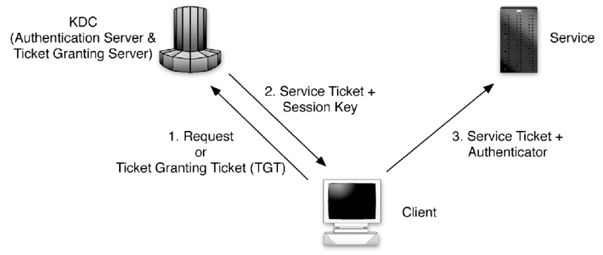
SQL Security Model
    Kerberose
      is a computer-network authentication protocol that works on the basis of tickets to allow nodes communicating over a non-secure network to prove their identity to one another in a secure manner.

Slide 14
SQL Security Model
Access control through views
  many security policies better expressed by granting privileges to views derived from base relations
  example
  CREATE VIEW AVSAL(DEPT, AVG)
    AS SELECT DEPT, AVG(SALARY)
    FROM EMP GROUP BY DEPT
    access can be granted to this view for every dept mgr
  example
  CREATE VIEW MYACCOUNT AS
  SELECT * FROM Account
  WHERE Customer = current_user()
    view containing account info for current user

Slide 15
SQL Security Model
Advantages of views
  views are flexible, and allow access control to be defined at a description level appropriate to application
  views can enforce context and data-dependent policies
  data can easily be reclassified
Notes:
DBMSs sometimes take special action to help catch errors as they are made and to correct errors after values are inserted.
the DBMS can apply field checks, activities that test for appropriate values in a position.
Check for value bounds , value types (numeric/character/boolean) , other conditions such as case
Access Controls : Who has authorization to update which elements? What if two people apply conflicting modifications?
What if modifications are applied out of sequence? How are duplicate records detected? What action is taken when duplicates are found?
Change logs : A change log lists every change made to the database; it contains both original and modified values. Using this log, a database administrator can undo any changes that were made in error.
Audibility
For some applications it may be desirable to generate an audit record of all access (read or write) to a database. to discover after the fact who had affected what values and when.
To be useful for maintaining integrity, database audit trails should include accesses at the record, field, and even element levels. This detail is prohibitive for most database applications.
Problem : A log of all records accessed directly may both overstate and understate what a user actually knows

Slide 16
SQL Security Model
Disadvantages of views
  access checking may become complex
  views need to be checked for correctness (do they properly capture policy?)
  completeness and consistency not achieved automatically - views may overlap or miss parts of database
  security-relevant part of DBMS may become very large (view results are stored)

Slide 17
SQL Security Model
Inherent weakness of DAC (discretionary access control)
  DAC is very flexible and suitable model for DBMS.
  As the name implies, DAC allows the creators or owners of files to assign access rights.
  Also, a user (or subject) with discretionary access to information can pass that information on to another user (or subject)
  Trojan horses to copy information from one object to another
Notes:
A Trojan Horse is rogue software installed perhaps unwittingly, by duly authorized users
A Trojan Horse does what a user expects it to do, but in addition exploits the user's legitimate privileges to cause a security breach
If the users don’t do it , a trojan horse al always do it

Slide 18
SQL Security Model
Mandatory Access Controls (MAC)
Mandatory Access Control (MAC) is system-enforced access control based on a subject’s clearance and an object’s labels. Subjects and Objects have clearances and labels, respectively, such as confidential, secret, and top secret. A subject may access an object only if the subject’s clearance is equal to or greater than the object’s label. Subjects cannot share objects with other subjects who lack the proper clearance, or “write down” objects to a lower classification level (such as from top secret to secret). MAC systems are usually focused on preserving the confidentiality of data.
  No read up, no write down
  Expensive to implement
  Traditional MAC implementations in RDBMS have focused solely on MLS (Multi-level Security)
  There have been three commercial MLS RDBMS offerings
    Trusted Oracle, Informix OnLine/Secure, Sybase Secure SQL Server

Slide 19
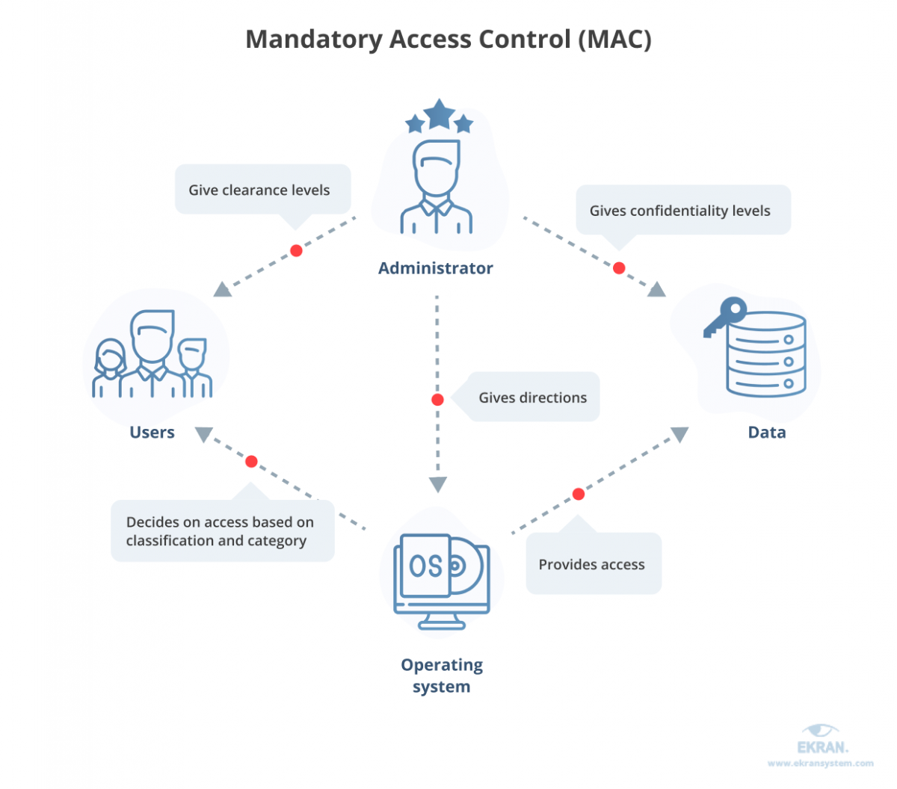
Mandatory Access Controls (MAC)

Slide 20
Mandatory Access Controls (MAC)
What are the basic principles of MAC?
The utmost privacy and confidentiality of the organization’s resources are paramount.
No one has default privileges to access or edit someone’s data.
Access provisioning is centrally administered.
Each individual and resource in the system has security labels with their classification and category.
With MAC, the process of gaining access looks like this:
The administrator configures access policies and defines security attributes: confidentiality levels, clearances for accessing different projects and types of resources.
The administrator assigns each subject (user or resource that accesses data) and object (file, database, port, etc.) a set of attributes.
When a subject attempts to access an object, the operating system examines the subject’s security attributes and decides whether access can be granted.
To obtain access to the object, the user provides their credentials.

Slide 21
Case Study
RECORDID | CLIENTNO | DEPTNO | ALLOCATION_DATE | LAST_UPDATE | MEDICAL_HISTORY | RISK_FACTOR
0010 | K108341 | K01 | 2006/01/05 | 2006/02/05 | Diabetes | 0
0020 | K104546 | K01 | 2006/10/20 | 2006/11/05 | Arthritis | 2
0030 | S245987 | S02 | 2006/09/01 | 2006/10/05 | High Blood Pressure | 3
0040 | S245456 | S02 | 2006/06/26 | 2006/07/05 | Asthma | 1
  Medical record analyst
    READ all records
    WRITE all records
  Managers
    READ client records of their department
    READ only non-confidential columns
    No WRITE access
Notes:
Global Life Financial requires all life insurance applicants to submit a Medical History report for analyzing the eligibility of their application. An applicant's medical history is highly confidential and should only be handled by the Medical Record Analysis department. Upon analyzing the report, that department comes up with a rating in form of a risk index. Department managers can then refer to the insurance risk index when they consider approving an insurance application. To maintain confidentiality, department managers cannot access the information related to the medical history of a client's record.

Slide 22
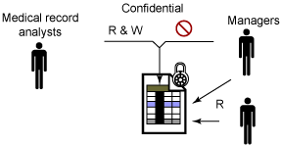
Case Study
Columns
  medical record analysts have READ/WRITE access to confidential columns
  managers have READ access to non-confidential columns
Rows:
  medical record analysts can read and update all the records
  managers can read but not update client records for their department

Slide 23
Case Study: DAC Solution
Three approaches used to provide row level security using DAC (Discretionary Access Control)
Application views
Programming logic embedded in the application
Physical separation using one or more databases

Slide 24
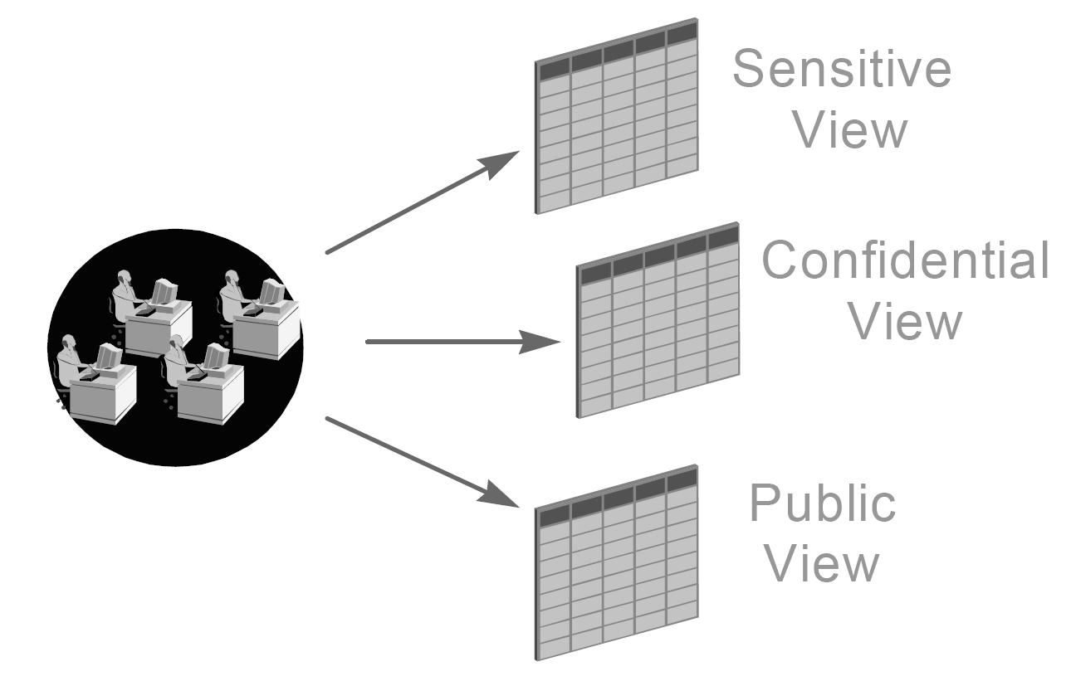
Case Study: DAC Solution
Application views
  Widely used approach
  Views provide the ability to filter data.

Slide 25
Case Study: DAC Solution
Create view manager_K01 as
select recordid, clientno,
deptno, allocation_date,
last_update,risk_factor
from Med_records
where Dept = ‘K01’;
Create view manager_S01 as
select recordid, clientno, deptno,
allocation_date, last_update, risk_factor
from Med_records
where Dept = ‘S01’;
Create view med_rec_analyst as
select * from Med_records;

Slide 26
Case Study: DAC Solution
Application views
  number of views required is sometimes large as application ages
  directing application users to the correct view becomes management burden
  application complexity tends to increase due to unforeseen security requirements

Slide 27
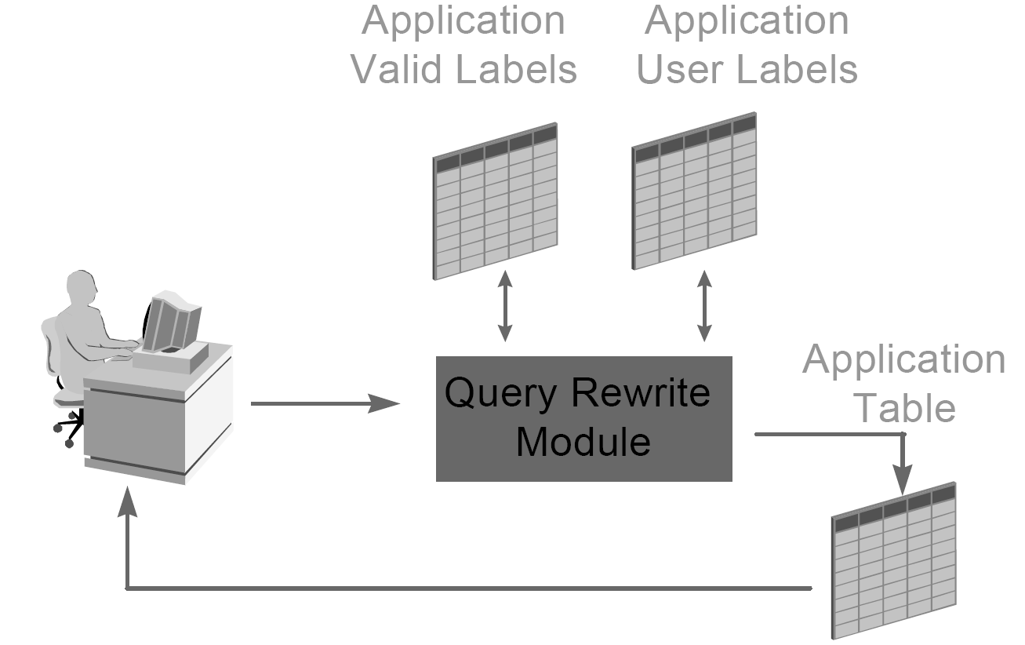
Case Study: DAC Solution
Queries can be modified/controlled before execution depending upon the users/authority
Application Programmatic Logic Approach
  in this approach, application controls SQL statements outside the application.

Slide 28
Case Study: DAC Solution
Application program logic approach
  SQL statements issued outside the application using utility such as SQL Plus can’t be controlled
  In scenario of application rewriting SQL statements to restrict access based on data sensitivity, typically numerous additional tables must be build
  Those tables need to be maintained to manage information related authorizations of application user

Slide 29
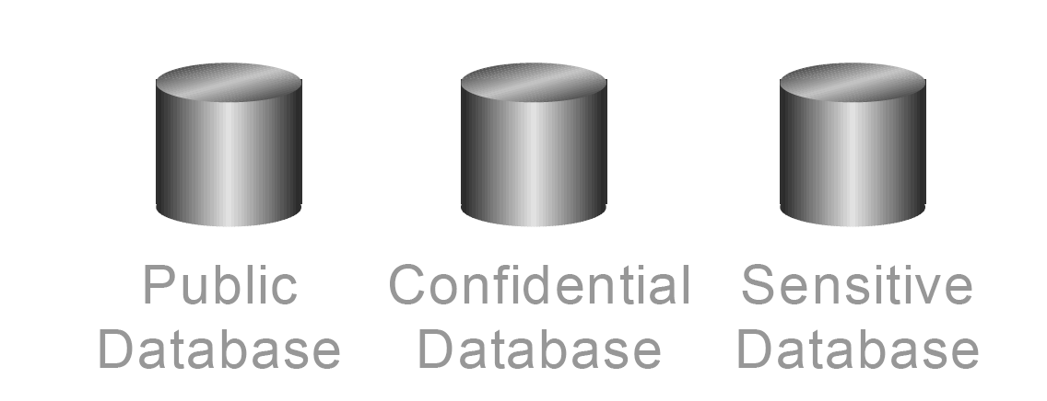
Case Study: DAC Solution
Multiple database approach
  No of databases required is equal to the number of data sensitivities.
  data can be protected by using dedicated databases to manage each sensitivity

Slide 30
Case Study: DAC Solution
Multiple database approach
  number of databases required is equal to the number of data sensitivities
  overhead created by running multiple databases in terms of memory, processing power and physical storage is substantially increased
  cost associated of managing single database is multiplied by number of databases
  viewing information across multiple database requires distributed queries and application logic

Slide 31
Case Study: MAC Solution
Designing security solution
  Row and column security labels that protect the columns and rows
  User security labels that grant users the appropriate access

Slide 32
Case Study: MAC Solution
  revisit the problem
  To restrict access to the column that is confidential, apply confidential security label to the column
  To restrict managers' access to only the records for their department, each row can be tagged with a security label that indicates the department.
  Write restriction for managers can be implemented by revoking their write privileges.
Position | READ | WRITE
Medical record analyst | ALL | ALL
Managers | Client records for their department and only non-confidential columns | None

Slide 33
Case Study: MAC Solution
A column security label.
Four security labels for row protection
User security label for medical record analysts
Grant security labels to users

Slide 34
SQL Security Model
Issues with MAC
  Information tends to becomes over classified
  No protection against violations that produce illegal information flow through indirect means
    Inference channels - A user at a low security class uses the low data to infer information about high security class
    Covert channels - require two active agents, one at a low level and the other at a high level and an encoding scheme
Notes:
A covert channel is a communication channel based on the use of system resources not normally intended for communication between the subjects (processes) in the system

Slide 35
Data Sensitivity
Sensitive data is data that should not be made public
Factors determining sensitivity
  Inherently sensitive: the value itself may be so revealing that it is sensitive
    Locations of defensive missiles
  From a sensitive source
    CIA informer whose identity may be compromised
  Part of a sensitive attribute or a sensitive record
    Salary attribute from an HR database
  Sensitive with respect to previously disclosed data
    Longitude of secret army base if latitude is known
Notes:
Inherently sensitive. The value itself may be so revealing that it is sensitive. Examples are the locations of defensive missiles or the median income of barbers in a town with only one barber.
From a sensitive source. The source of the data may indicate a need for confidentiality. An example is information from an informer whose identity would be compromised if the information were disclosed.
Declared sensitive. The database administrator or the owner of the data may have declared the data to be sensitive. Examples are classified military data or the name of the anonymous donor of a piece of art.
Part of a sensitive attribute or a sensitive record. In a database, an entire attribute or record may be classified as sensitive. Examples are the salary attribute of a personnel database or a record describing a secret space mission.
Sensitive in relation to previously disclosed information. Some data become sensitive in the presence of other data. For example, the longitude coordinate of a secret gold mine reveals little, but the longitude coordinate in conjunction with the latitude coordinate pinpoints the mine.

Slide 36
Data Sensitivity
Even metadata (data about data) may be sensitive
  Bounds: indicating that a sensitive value, y, is between two values, L and H.
  Negative result: disclosing that z is not the value of y may be sensitive. Especially when z has only small set of possible values
  Existence: existence of data is itself may be sensitive piece of data
  Probable value: probability that a certain element has a certain value

Slide 37
Security vs. Precision
Precision: revealing as much non sensitive data as possible
  disclose as much data as possible
  Issue: User may put together pieces of disclosed data and infer other, more deeply hidden, data
Security: reveal only those data that are not sensitive
  rejecting any query that mentions a sensitive field
  Issue: may reject many reasonable and non disclosing queries
The ideal combination : perfect confidentiality with maximum precision
  achieving this goal is not easy !

Slide 38
Statistical Databases
A statistical database is a database used for statistical analysis purposes. It is an OLAP (online analytical processing), instead of OLTP (online transaction processing) system.
Example: medical record database where researchers access only statistical measures
In a statistical database, information retrieved by means of statistical (aggregate) queries on an attribute
Notes:
used for information dissemination and research while keeping individual data values confidential
A medical record database that supports medical research and doctors. Doctors read and update patient data
Researches only do statistical queries

Slide 39
Statistical Databases
In a statistical database, it is often desired to allow query access only to aggregate data, not individual records.
Securing such a database is a difficult problem, since intelligent users can use a combination of aggregate queries to derive information about a single individual.
Notes:
used for information dissemination and research while keeping individual data values confidential
A medical record database that supports medical research and doctors. Doctors read and update patient data
Researches only do statistical queries

Slide 40
Inference
Security issue with statistical databases
  Inference problem exists when sensitive data can be deduced from non sensitive data
  Attacker combines information from outside the database with database responses
Notes:
Inference and aggregation differ from other security problems since the leakage of information is
not a result of the penetration of a security mechanism but rather it is based on the very nature of
the information and the semantics of the application being automated
Cardinal Aggregation Examples
The traditional example of cardinal aggregation is the intelligence agency telephone book:
individual entries are unclassified but the total book is classified [Lunt 89]. The challenge with this
example is understanding what information the agency is trying to protect with the policy. Is it the
name and number of staff personnel (and therefore capability) of each (or some) organizational
element? The total staffing size of the agency? Identification of special employees? Special skills?
A clear understanding of what information needs to be protected must precede a cardinal
aggregation policy.

Slide 41
Inference
Anonymous medical data:
SSN
Name
Race
DOB
Sex
Zip
Marital
Heath
Asian
09/07/64
F
22030
Married
Obesity
Black
05/14/61
M
22030
Married
Obesity
White
05/08/61
M
22030
Married
Chest pain
White
09/15/61
F
22031
Widow
Aids
Public available voter list:
Name
Address
City
Zip
DOB
Sex
Party
….
….
….
….
….
….
….
Sue Carlson
900 Market St.
Fairfax
22031
09/15/61
F
Democrat
Sue Carlson has Aids!
Notes:
Count females of a certain age group in certain zipcode who have aids
We now know that there is only one such female
(Should return no data as one record represents over 100% of result)
Later request a list of female voters by name who are within certain age group

Slide 42
Inference
Types of attack
  Direct attack: aggregate computed over a small sample so individual data items leaked
  Indirect attack: infer sensitive info from statistics (sum, count, median) also from info external to the attacked DB
    Tracker attack: (intersection of sets)
    Linear system vulnerability: takes tracker attacks further, using algebraic relations between query sets to construct equations yielding desired information

Slide 43
Inference
NAME SEX RACE AID FINES DRUGS DORM
Adams M C 5000 45 1 Holmes
Bailey M B 0 0 0 Grey
Chin F A 3000 20 0 West
Dewitt M B 1000 35 3 Grey
Earhart F C 2000 95 1 Holmes
Fein F C 1000 15 0 West
Groff M C 4000 0 3 West
Hill F B 5000 10 2 Holmes
Koch F C 0 0 1 West
Liu F A 0 10 2 Grey
Majors M C 2000 0 2 Grey

Slide 44
Inference
Direct Attack
  Determine values of sensitive fields by seeking them directly with queries that yield few records
  LIST NAME where SEX=M and DRUGS=1
  “n items over k percent” rule helps prevent attack

Slide 45
Inference
Indirect attack: combines several aggregates
    1 Male in Holmes receives 5000
    1 Female in Grey received no aid
Sums of Financial Aid by Dorm and Sex
 | Holmes | Grey | West | Total
M | 5000 | 3000 | 4000 | 12000
F | 7000 | 0 | 4000 | 11000
Total | 12000 | 3000 | 8000 | 23000
Students by Dorm and Sex
 | Holmes | Grey | West | Total
M | 1 | 3 | 1 | 5
F | 2 | 1 | 3 | 6
Total | 3 | 4 | 4 | 11

Slide 46
Inference
Often databases protected against delivering small response sets to queries
Trackers can identify unique value
  request (n) and (n-1) values
  given n and n – 1, we can easily compute the desired single element

Slide 47
Inference
How many Caucasian females live in Holmes Hall?
  Count((sex=f)∧(race=c) ∧(dorm=holmes)
  Result: refused because one record dominates the result
  Now issue two queries on database
    Count(sex=f) response = 6
    Count((sex=f) ∧(RACE≠ C) ∧(DORM ≠holmes)) response=5
  Thus 5-4=1 females live in holmes hall

Slide 48
Inference
Tracker is a specific case of ‘Linear system vulnerability’
  result of the query is a set of records
    q1 = c1+c2+c3+c4+c5
    q2 = c1+c2 +c4
    q3 = c3+c4
    q4 = c4+c5
    q5 = c2 +c5
  we can obtain c5 = ((q1 – q2) – (q3 –q4))/2
  all other c can be derived

Slide 49
Inference
Protection techniques
Only queries disclosing non sensitive data allowed
Controls applied to individual items within the database

Slide 50
Multilevel Databases
Data sensitivity not black or white
  Exist shades of sensitivity
  Grades of security may be needed
So far we have seen sensitivity a function of the attribute (column)
  E.G. ‘Drug use’ column sensitive
Actually sensitivity not function of column or row
  The security of one element may be different from that of other elements of the same row or column
  Security implemented for each individual element
Notes:
If Data was either sensitive or non sensitive , will be easy to manage
some databases, such as a public library catalog, contain no sensitive data; other databases, such as defense-related ones, are totally sensitive. These two cases—nothing sensitive and everything sensitive—are the easiest to handle, because they can be covered by access controls to the database itself. Someone either is or is not an authorized user.

Slide 51
Multilevel Databases
Data and Attribute Sensitivity
Name | Department | Salary | Phone | Performance
Rogers | training | 43,800 | 4-5067 | A2
Jenkins | research | 62,900 | 6-4281 | D4
Poling | training | 38,200 | 4-4501 | B1
Garland | user services | 54,600 | 6-6600 | A4
Hilten | user services | 44,500 | 4-5351 | B1
Davis | admin | 51,400 | 4-9505 | A3
Notes:
Consider a database containing data on U.S. government expenditures. Some of the expenditures are for paper clips, which is not sensitive information. Some salary expenditures are subject to privacy requirements. Individual salaries are sensitive, but the aggregate (for example, the total Agriculture Department payroll, which is a matter of public record) is not sensitive.
Sensitive information in bold
Table lists employee information. It may in fact be the case that Davis is a temporary employee hired for a special project, and her whole record has a different sensitivity from the others. Perhaps the phone shown for Garland is her private line, not available to the public.

Slide 52
Multilevel Databases
Leads to Multi Level Security Model
  n levels of sensitivity
  Objects separated into compartments by category
  Sensitivity marked for each value in database
  Every combination of elements can also have a distinct sensitivity
  Access control policy dictate which users may have access to what data
Notes:
And the problem is still more complicated. The word Manhattan by itself is not sensitive, nor is project. However, the combination of these words produces the sensitive codeword Manhattan project. A similar situation occurs in databases. Therefore, not only can every element of a database have a distinct sensitivity, every combination of elements can also have a distinct sensitivity. Furthermore, the combination can be more or less sensitive than any of its elements.

Slide 53
Multilevel Databases
To preserve Integrity, DBMS must enforce “No write down” (property)
  the process that reads high level data cannot write to a lower level

Slide 54
Multilevel Databases
Polyinstantiation
  different users operating at two different levels of security might get two different answers to the same query
  one record can appear (be instantiated) many times, with a different level of confidentiality each time
Polyinstantiated Records
Name | Sensitivity | Assignment | Location
Hill, Bob | C | Program Mgr | London
Hill, Bob | TS | Secret Agent | South Bend
Notes:
Enforcing confidentiality also leads to unknowing redundancy. Suppose a personnel specialist works at one level of access permission. The specialist knows that Bob Hill works for the company. However, Bob's record does not appear on the retirement payment roster. The specialist assumes this omission is an error and creates a record for Bob.
The reason that no record for Bob appears is that Bob is a secret agent, and his employment with the company is not supposed to be public knowledge. There actually is a record on Bob in the file but, because of his special position, his record is not accessible to the personnel specialist. The creation of the new record means that there are now two records for Bob Hill: one sensitive and one not, as shown in Table 6-17. This situation is called polyinstantiation, meaning that one record can appear (be instantiated) many times, with a different level of confidentiality each time.

Slide 55
Case Study
RECORDID | CLIENTNO | DEPTNO | ALLOCATION_DATE | LAST_UPDATE | MEDICAL_HISTORY | RISK_FACTOR
0010 | K108341 | K01 | 2006/01/05 | 2006/02/05 | Diabetes | 0
0020 | K104546 | K01 | 2006/10/20 | 2006/11/05 | Arthritis | 2
0030 | S245987 | S02 | 2006/09/01 | 2006/10/05 | High Blood Pressure | 3
0040 | S245456 | S02 | 2006/06/26 | 2006/07/05 | Asthma | 1
  Medical record analyst
    READ all records
    WRITE all records
  Managers
    READ client records of their department
    READ only non-confidential columns
    No WRITE access
Notes:
Global Life Financial requires all life insurance applicants to submit a Medical History report for analyzing the eligibility of their application. An applicant's medical history is highly confidential and should only be handled by the Medical Record Analysis department. Upon analyzing the report, that department comes up with a rating in form of a risk index. Department managers can then refer to the insurance risk index when they consider approving an insurance application. To maintain confidentiality, department managers cannot access the information related to the medical history of a client's record.

Slide 56
Case Study: MAC Solution
Example of steps to implement (Label-based Access Control) LBAC:
Defining the security policies and labels
  Defining the security label component
    CREATE SECURITY LABEL COMPONENT SLC_LEVEL
    SET {'CONFIDENTIAL'}
  CREATE SECURITY LABEL COMPONENT SLC_LIFEINS_ORG TREE {'LIFE_INS_DEPT' ROOT,
'K01' UNDER 'LIFE_INS_DEPT',
'K02' UNDER 'LIFE_INS_DEPT',
'S01' UNDER 'LIFE_INS_DEPT',
'S02' UNDER 'LIFE_INS_DEPT' }
  b. Defining the security policy
  CREATE SECURITY POLICY MEDICAL_RECORD_POLICY COMPONENTS SLC_LEVEL, SLC_LIFEINS_ORG
  WITH DB2LBACRULES
    RESTRICT NOT AUTHORIZED WRITE SECURITY LABEL

Slide 57
Case Study: MAC Solution
c. Defining the security labels
  CREATE SECURITY LABEL MEDICAL_RECORD_POLICY.MED_RECORD COMPONENT SLC_LEVEL 'CONFIDENTIAL'
  For each department,
  CREATE SECURITY LABEL MEDICAL_RECORD_POLICY.LIFEINS_DEPT_K01 COMPONENT SLC_LIFEINS_ORG 'K01'
  For Medical analyst
CREATE SECURITY LABEL MEDICAL_RECORD_POLICY.MEDICAL_ANALYST COMPONENT SLC_LEVEL 'CONFIDENTIAL', COMPONENT SLC_LIFEINS_ORG 'K01', 'K02', 'S01', 'S02'

Slide 58
Case Study: MAC Solution
2. Altering the MEDICAL_RECORD table by adding a security label column for row level protection, marking the confidential column as protected, and attaching the security policy to the table.
  GRANT SECURITY LABEL MEDICAL_RECORD_POLICY.MEDICAL_ANALYST TO USER <administrator_auth_id> FOR ALL ACCESS
  ALTER TABLE MEDICAL_RECORD ALTER COLUMN MEDICAL_HISTORY SECURED WITH MEDICAL_RECORD_POLICY.MED_RECORD ADD COLUMN DEPARTMENT_TAG DB2SECURITYLABEL ADD SECURITY POLICY MEDICAL_RECORD_POLICY

Slide 59
Case Study: MAC Solution
3. Updating the MEDICAL_RECORD table security label column.
GRANT EXEMPTION ON RULE DB2LBACWRITETREE FOR MEDICAL_RECORD_POLICY TO USER <administrator_auth_id>
For each department,
UPDATE MEDICAL_RECORD set DEPARTMENT_TAG= SECLABEL_BY_NAME ('MEDICAL_RECORD_POLICY', 'DEPT_K01') where DEPTNO='K01'

Slide 60
LBAC(Label Based Access Control)
Granting the appropriate security labels to users.
  GRANT SECURITY LABEL MEDICAL_RECORD_POLICY. MEDICAL_ANALYST TO USER PETER FOR ALL ACCESS
  GRANT SECURITY LABEL MEDICAL_RECORD_POLICY.DEPT_K01 TO USER Andrea FOR ALL ACCESS
  GRANT SECURITY LABEL MEDICAL_RECORD_POLICY.DEPT_S02 TO USER Joseph for ALL ACCESS

